Slide 1
Compare the Parthenon and the Coliseum
Today, we’re going look at architecture, a kind of art, and how that can be like reading. Our goal is to ask and answer questions about buildings and their uses like we do about an author and purpose.
Score yourself:
4: I can teach this
3: I can do this all by myself
2: I might need help
1: I think this is new

Slide 2
Architecture as Art
Look at the building on the next slide for 3 minutes.
What was the use of this building? Is it still used? If it’s not still used, why hasn’t it been torn down?
Use the 3 minutes to think.

Slide 3
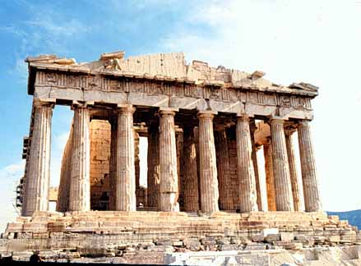
Outside of the Parthenon Athenian Acropolis, Greece, 438 BCE

Slide 4
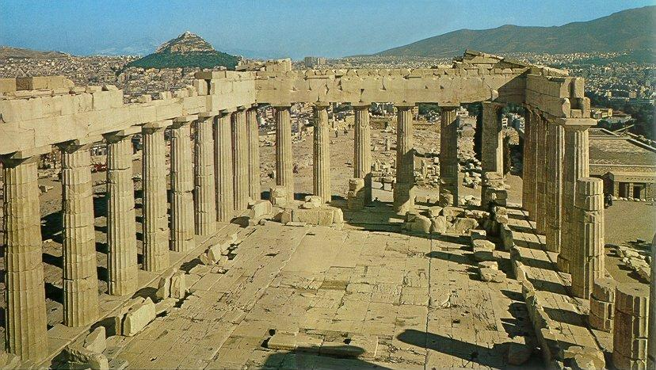
Inside the Parthenon

Slide 5
Talk to a Partner
Ask your partners what they think this building was used for. Give 3 reasons why.
Look and think: What 1 word would you use to describe this building?

Slide 6
Talk to a Partner
Ask your partners if they think this building is still used. If it is still used, what is it used for?
Look and think: If this building is not still used, why hasn’t it been torn down?

Slide 7
The Parthenon
The Parthenon was built in Athens, Greece, as a temple to the goddess Athena. People who wanted her to be nice to them would go there to ask her for favors. The city of Athens was named after Athena.
This statue of Athena is in a new building called the Parthenon, in Tennessee.

Slide 8
Look at the building on the next slide for 3 minutes.
What was the use of this building? Is it still used? If it’s not still used, why hasn’t it been torn down?
Use the 3 minutes to think.

Slide 9
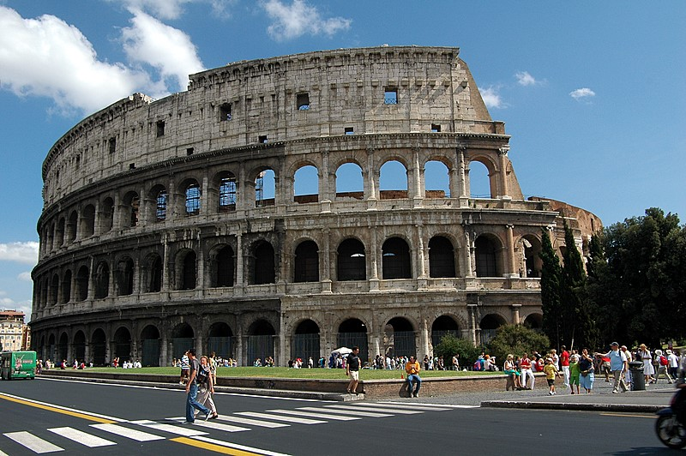
Outside of the Coliseum Rome, Italy 80 a.d.

Slide 10
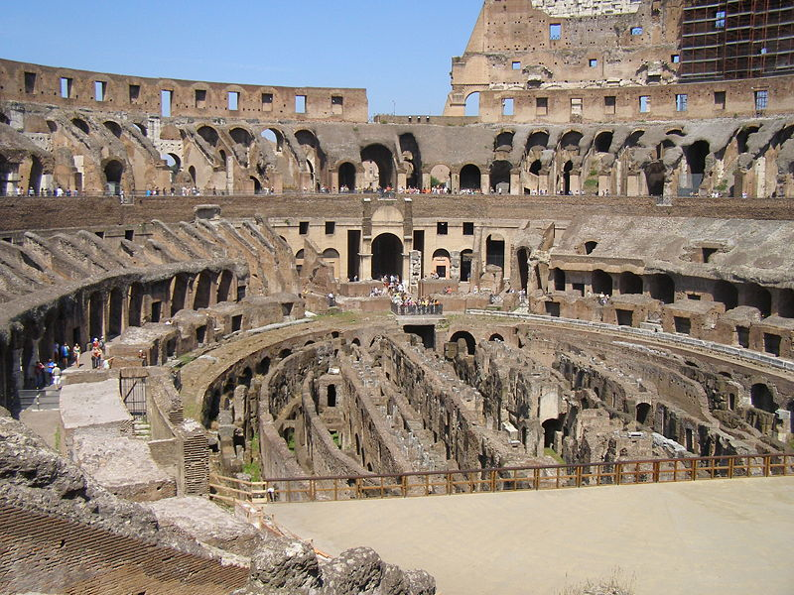
Inside the Coliseum

Slide 11
Talk to a Partner
Ask your partners what they think this building was used for. Give 3 reasons why they think that.
Look and think: What 1 word would you use to describe this building?

Slide 12
Talk to a Partner
Ask your partners if they think this building is still used. If it is still used, what is it used for?
Look and think: If this building is not still used, why hasn’t it been torn down?

Slide 13
The Coliseum
The Coliseum was used as an arena for sports and other public events.
There is now a sports arena in California called the Coliseum. It also hosts sporting and other public events.

Slide 14
Talk to your partner about one way the use of these buildings was similar and one way they were different.
Coliseum
Parthenon

Slide 15
Compare Coliseum and the Parthenon
Today, we’ve seen how looking at architecture as art can be like reading. Our goal was to ask and answer questions about buildings and their uses like we do about an author and purpose.
Score yourself:
4: I can teach this
3: I can do this all by myself
2: I might need help
1: I think this is new

